Slide 1



Slide 2

TABLE OF CONTENTS
ABOUT US
01
03
Payment choices
OUR SERVICES
02
4
bonus

Slide 3

ABOUT us
Welcome to Soul Travel – an award winning sustainable travel blog with a mission to restore the quest in travel, and help you discover the most amazing positive-impact, sustainable and transformative travel out there. Are you ready to discover the most exciting and sustainable places to visit in the world?

Slide 4
PROJECTS
canada
switzerland
morocco
australia

Slide 5

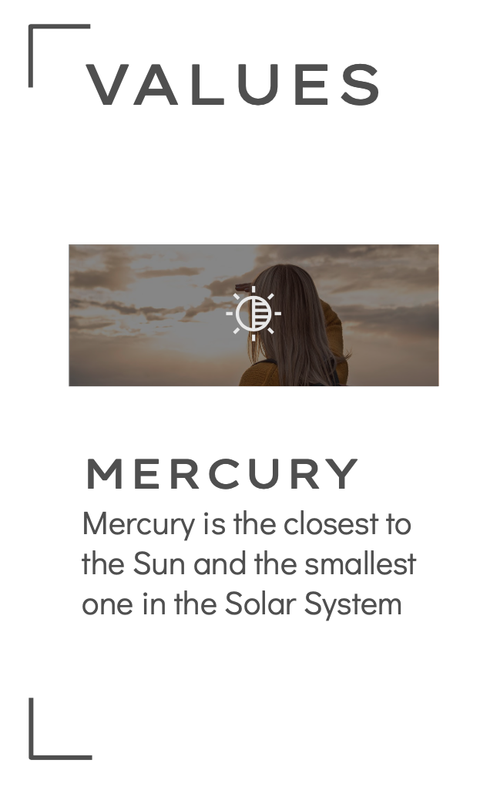
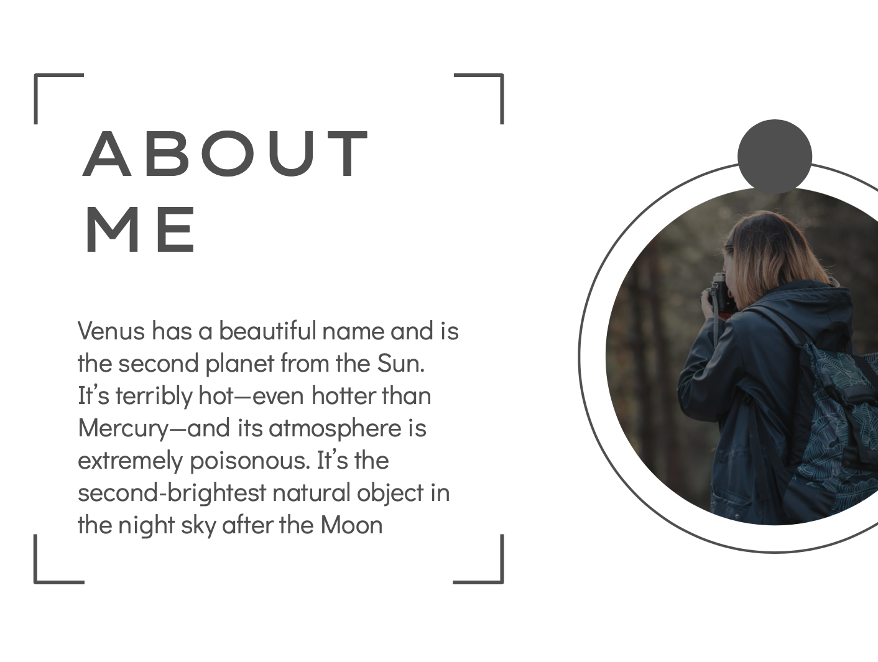
ONLINE SERVICES

